Slide 1


Dorothy Teng
22 Oct 21

Slide 2

Outline
Executive Summary
Introduction
Methodology
Results
Conclusion
Appendix

Slide 3
Executive Summary
We collect data by requesting data from Launch API, followed by processing the data by narrowing down to Falcon 9 launches and filling in the missing data. Importantly we created a new column of data indicating the success of the launch (hence able to reuse the first stage). To explore the data, we use SQL queries to determine if the first stage will land and visualization to identify features that have influence over the success of launch or the second stage. We used Folium to look at the launch sites on the map relevant to its proximities and marks its successes and failures along with it. We build a dashboard to look at the success rate of relative launch sites as well as the effect of payload ranges and booster versions on the success. Lastly, we develop and evaluate classification models to do a predictive analysis if the first stage will land.
We identify the following features that is used in success prediction: ‘FlightNumber', 'PayloadMass', 'Orbit', 'LaunchSite', 'Flights', 'GridFins', 'Reused', 'Legs', 'LandingPad', 'Block', 'ReusedCount', 'Serial’. We find accuracy score for classification models tested - SVM, Classification Trees, Logistic Regression and KNN, to be equivalent and hence can be utilized for all.

Slide 4
Introduction
SpaceX advertises Falcon 9 rocket launches on its website with a cost of 62 million dollars while other providers cost upwards of 165 million dollars each and much of the savings is because SpaceX can reuse the first stage. Therefore, if one can determine if the first stage will land, we can determine the cost of a launch.
Space Y founded by Billionaire industrialist Allon Musk would like to compete with SpaceX . Our job is to:
determine the price of each launch by gathering information about Space X and creating dashboards.
determine if SpaceX will reuse the first stage by training a machine learning model using public information

Slide 5


Slide 6
Methodology
Executive Summary
Data collection methodology:
We used API to call the relevant data
Perform data wrangling
We fill in missing values and created a class column to determine success or failure outcome.
Perform exploratory data analysis (EDA) using visualization and SQL
Perform interactive visual analytics using Folium and Plotly Dash
Perform predictive analysis using classification models
How to build, tune, evaluate classification models

Slide 7
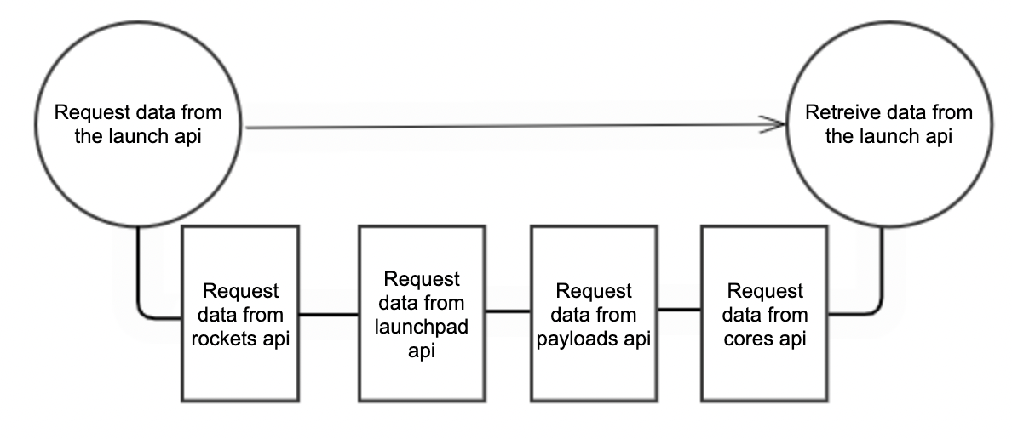
Data Collection – SpaceX API
We will use API to extract information using identification numbers in the launch data.
The following columns is used to call the API to append the relevant data to the list - ’rocket’, ‘launchpad’, ’payloads’ and ‘core’.
Github: https://github.com/Dotmeads/IBMCapstoneSpaceX/blob/b1c1a0d80f3ca8638d1333af5064cd88c42c8dcb/Data%20Collection%20API%20Lab%20.ipynb

Slide 8
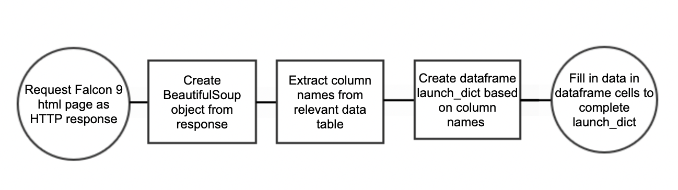
Data Collection – Web Scraping
We request the Falcon9 Launch HTML page and make a beautiful soup object from the response.
Then we extract the column table names from the relevant table.
Next, a dictionary is created based on the column names and convert it to a dataframe launch_dict.
Lastly, we fill in the individual data values in the dataframe.
Github: https://github.com/Dotmeads/IBMCapstoneSpaceX/blob/b1c1a0d80f3ca8638d1333af5064cd88c42c8dcb/Webscraping.ipynb

Slide 9
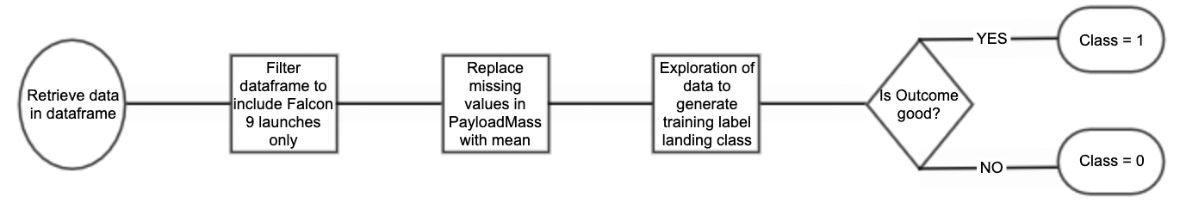
Data Wrangling
Firstly, we removed data related to Falcon 1 launches from the dataframe to include only the Falcon 9 launches.
Next, missing values in PayloadMass column were replaced with column mean to include these data rows.
After some exploration of data, the training label ‘Class’ would be built based on ‘Outcome’ column which indicates if the landing class was a good or bad outcome.
Github:
https://github.com/Dotmeads/IBMCapstoneSpaceX/blob/b1c1a0d80f3ca8638d1333af5064cd88c42c8dcb/Data%20Collection%20API%20Lab%20.ipynb
https://github.com/Dotmeads/IBMCapstoneSpaceX/blob/b1c1a0d80f3ca8638d1333af5064cd88c42c8dcb/Data%20Wrangling%20.ipynb

Slide 10
EDA with Data Visualization
Following charts are plotted:
Flight Number & Payload Mass: To examine success due to flight number and Payload Mass
Flight Number & Launch site : To examine if Launch Site success is due to earlier or later flights at the site
Payload Mass & Launch Site: To examine if Launch Site success is due to lighter or heavier payload mass.
Success rate of each Orbit type: To see which is the most successful orbit
Flight Number & Orbit type: To examine if Orbit success is due to earlier or later flights at the site
Payload Mass & Orbit type : To examine if Orbit success is due to lighter or heavier payload mass.
Launch success yearly trend : To examine success over time
Github:
https://github.com/Dotmeads/IBMCapstoneSpaceX/blob/b1c1a0d80f3ca8638d1333af5064cd88c42c8dcb/EDA%20with%20Visualization%20lab.ipynb

Slide 11
EDA with SQL
SQL queries were performed to display the following:
Names of the unique launch sites
5 records where launch sites begin with the string 'CCA’
Total payload mass carried by boosters launched by NASA (CRS)
Average payload mass carried by booster version F9 v1.1
The date when the first successful landing outcome in ground pad was achieved
The names of the boosters which have success in drone ship and have payload mass greater than 4000 but less than 6000
List of total number of successful and failure mission outcomes
List of names of the booster_versions which have carried the maximum payload mass.
List of the failed landing_outcomes in drone ship, their booster versions, and launch site names for in year 2015
Rank the count of landing outcomes (such as Failure (drone ship) or Success (ground pad)) between the date 2010-06-04 and 2017-03-20
Github: https://github.com/Dotmeads/IBMCapstoneSpaceX/blob/4a517d8cf2797a92620ae30c69efdefe365283de/EDA%20with%20SQL%20.ipynb

Slide 12
Build an Interactive Map with Folium
We added markers on the map identify the location and proximity of the launch sites so we can better understand how the position of rocket trajectories can influence the success of the launch. We will look at the factors that may affect the launch site being an ideal location of launch.
We mark and color code the success and failure of the launches on the map to see its probability of success thus far.
We also identify the relative distance of the launch sites from proximities such as railway, city and highway to see if it has influence on the success of the launch.
Github:
https://github.com/Dotmeads/IBMCapstoneSpaceX/blob/4a517d8cf2797a92620ae30c69efdefe365283de/Interactive%20Visual%20Analytics%20with%20Folium%20lab.ipynb

Slide 13
Build a Dashboard with Plotly Dash
We added a pie chart showing the success rate of the launch sites. We used a dropdown to select the individual launch sites on top of the option of all sites so we can examine the individual success rate of each site as well as proportion of successful launches in comparison of other thing.
Next, we have a scatter plot of Payload mass(kg) plotted against class (indicating success rate) of different boosters. We used a slider so we can manipulate the maximum and minimum payload mass in the chart. This allows us to look at the distribution of successful and non successful launches of different booster version in different payload range.
Github: https://github.com/Dotmeads/IBMCapstoneSpaceX/blob/54b0573855a3560d5d9c1a09cd9e09f3da6c7bbf/SpaceXapp.py

Slide 14
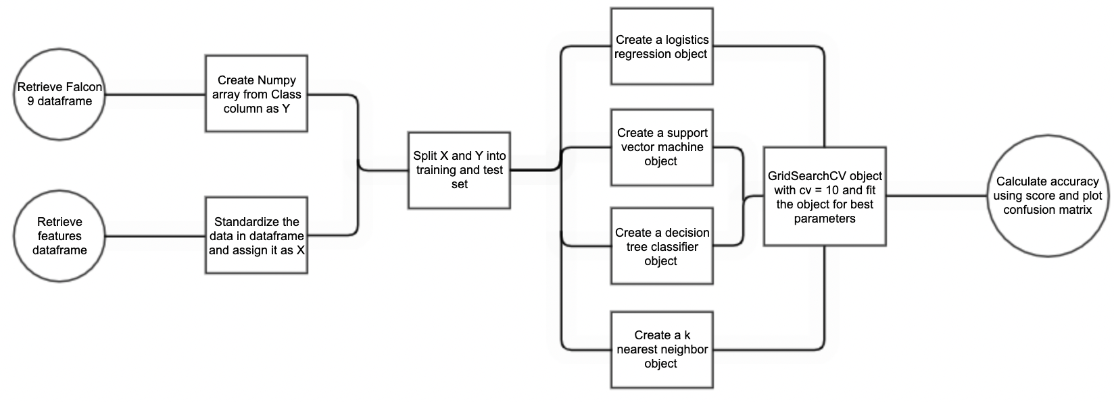
Predictive Analysis (Classification)
We retrieved Falcon 9 dataframe obtained from Data wrangling (slide 10) and features dataframe based on the former dataframe but with added dummy columns of Orbits, LaunchSite, LandingPad, and Serial.
We built X and Y respectively and split them into training and testing sets. We then create SVM, Classification Trees, Logistic Regression and KNN objects. In each method, we create a GridsearchCV with cv=10, fit the object to find the best parameter using the training data and subsequently test the accuracy using the score method on the test data. Lastly, we look at the confusion matrix for each method.
Github: https://github.com/Dotmeads/IBMCapstoneSpaceX/blob/54b0573855a3560d5d9c1a09cd9e09f3da6c7bbf/Machine%20Learning%20Prediction%20lab.ipynb

Slide 15


Slide 16
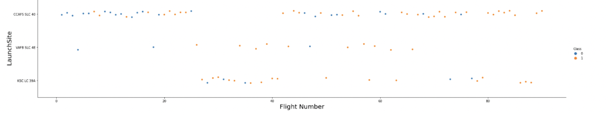
Flight Number vs. Launch Site
CCAFS LC-40 has lesser success in proportion compared to KSC LC-39A and VAFB SLC 4E because earlier flights are more prone to failure and CCAFS LC-40 has more flights in the initial stage.

Slide 17
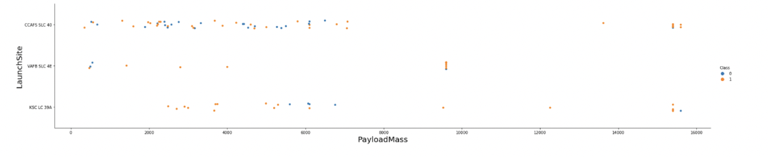
Payload vs. Launch Site
PayloadMass at VAFB SLC 4E never exceeded 10 000 kg but with high chance of success. CCAFS LC-40 shows success in launching the heaviest Payload.

Slide 18
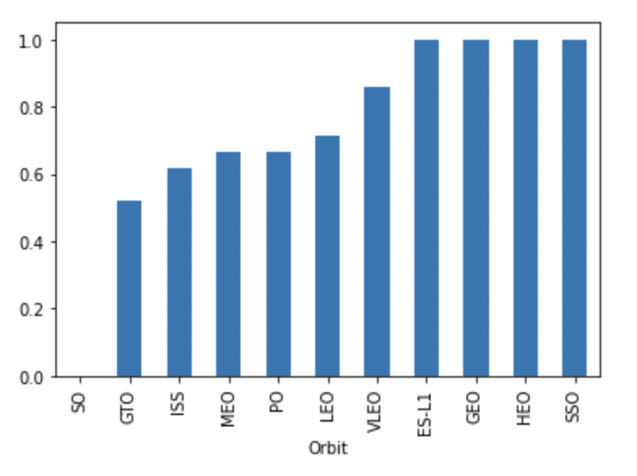
Success Rate vs. Orbit Type
4 Orbits - ES-L1, GEO, HEO, SSO has equal and highest rate of success of 100% among the orbits.

Slide 19
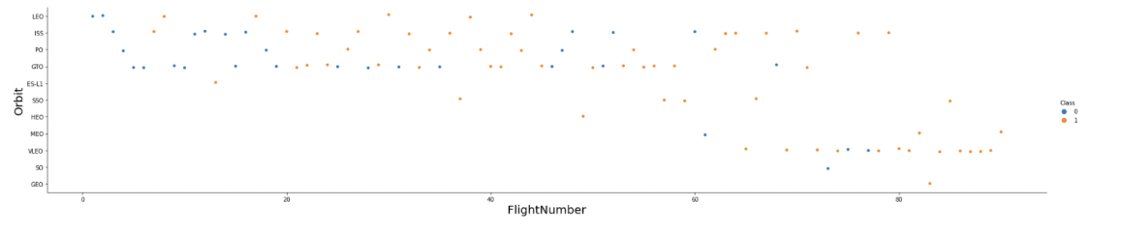
Flight Number vs. Orbit Type
Orbits ES-L1, GEO, HEO, SSO with 100% success has very little number (<5) of launches hence skewing the percentage of success. Likewise, SO only had one launch and it is unsuccessful hence 0% success rate.

Slide 20
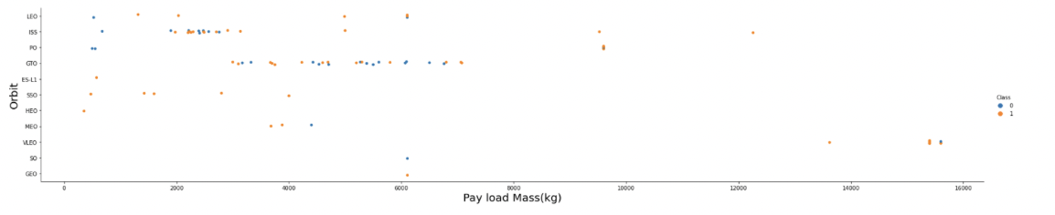
Payload vs. Orbit Type
Heavier payloads have a negative influence on GTO orbits and positive on LEO and ISS orbits

Slide 21
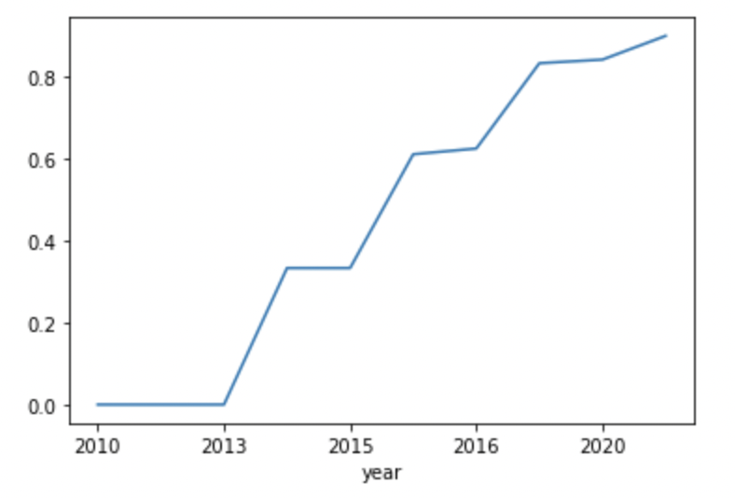
Launch Success Yearly Trend
Success rate of the launch has increased since 2013 till 2020. There was no successful launch before 2013.

Slide 22
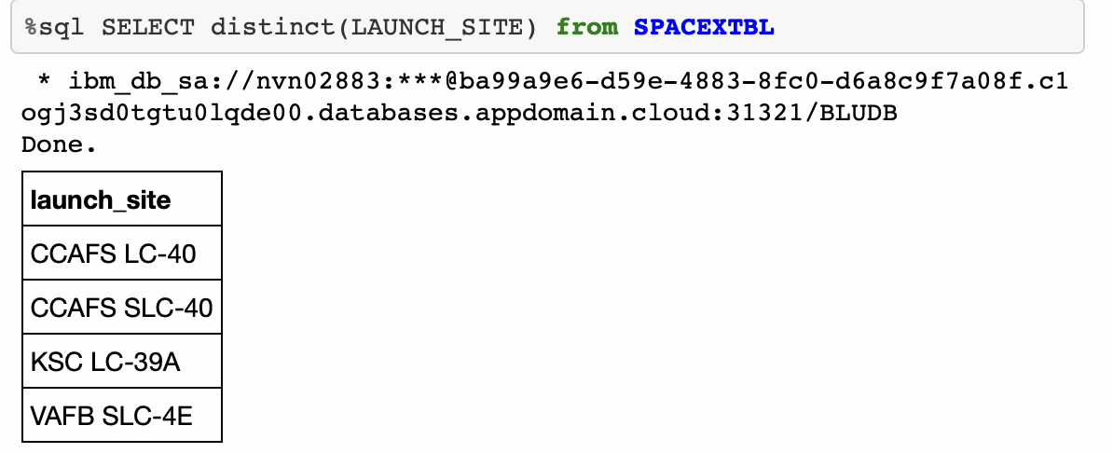
All Launch Site Names
We use SELECT DISTINCT statement to return only distinct (different) values of column launch site as it would contain many duplicate values.

Slide 23
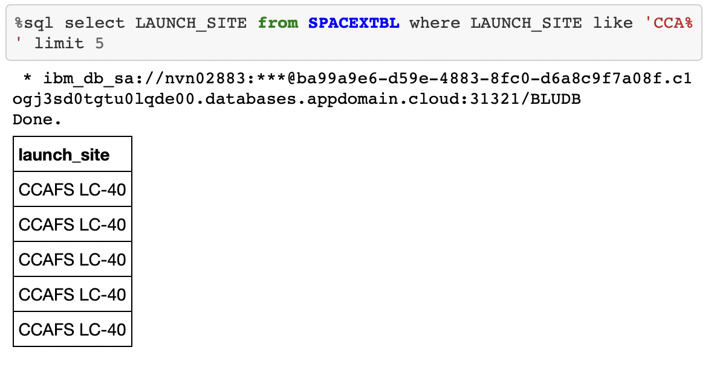
Launch Site Names Begin with 'CCA'
We use SELECT statement and limit to 5 entries of Launchsite column containing starting with CCA.

Slide 24
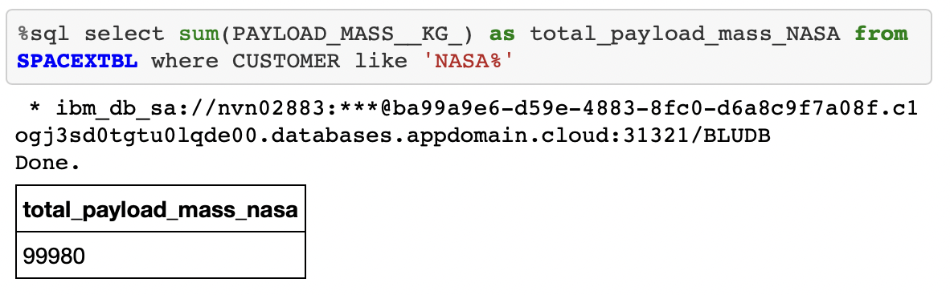
Total Payload Mass
The total payload carried by boosters from NASA is calculated by using sum of PAYLOAD_MASS_KG column where the customer column contains ‘NASA’.

Slide 25
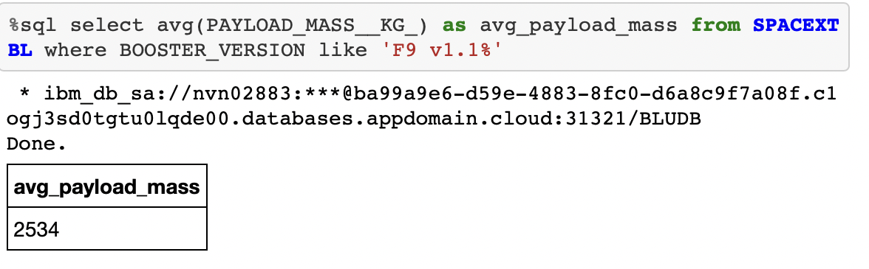
Average Payload Mass by F9 v1.1
Calculate the average payload mass carried by booster version F9 v1.1 using avg function on payload mass for rows with booster version containing ’F9 v1.1’.

Slide 26
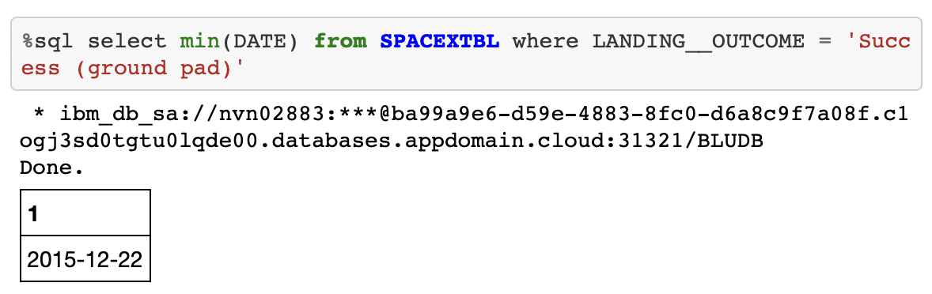
First Successful Ground Landing Date
We find the earliest date using min function on dates whose rows contain ‘Success (ground pad)’

Slide 27
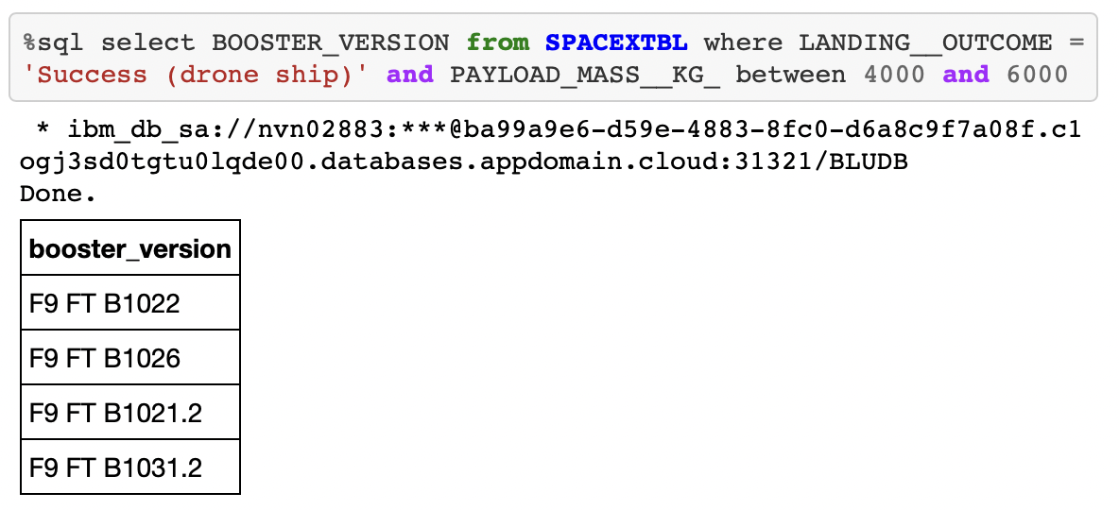
Successful Drone Ship Landing with Payload between 4000 and 6000
Result is derived by selecting the booster using the where clause, limiting to results in landing outcome coloumn to ‘Success (drone ship)’ and payload outcome to between 4000 and 6000.

Slide 28
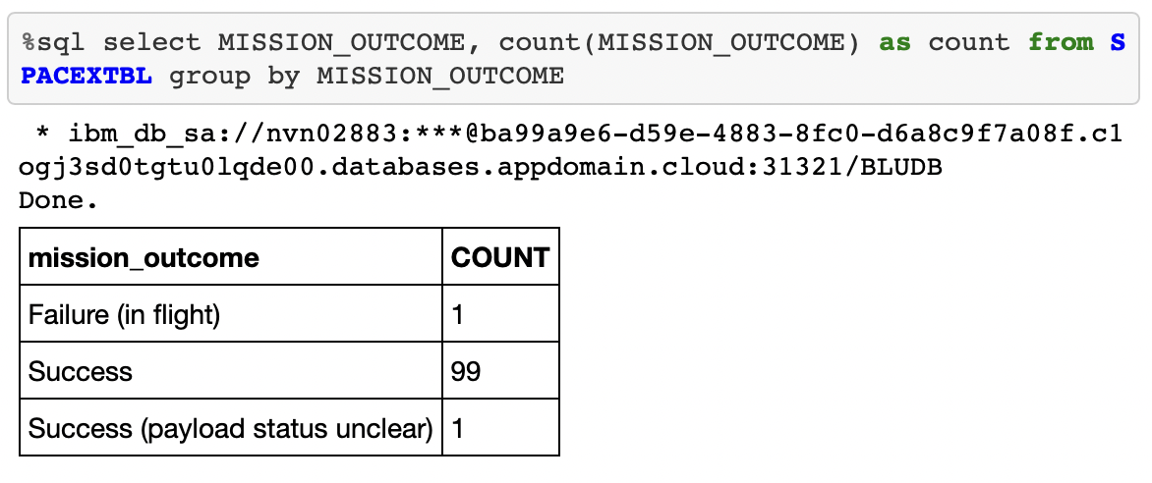
Total Number of Successful and Failure Mission Outcomes
Calculate the total number of successful and failure mission outcomes using the counts of the values under mission outcomes.

Slide 29
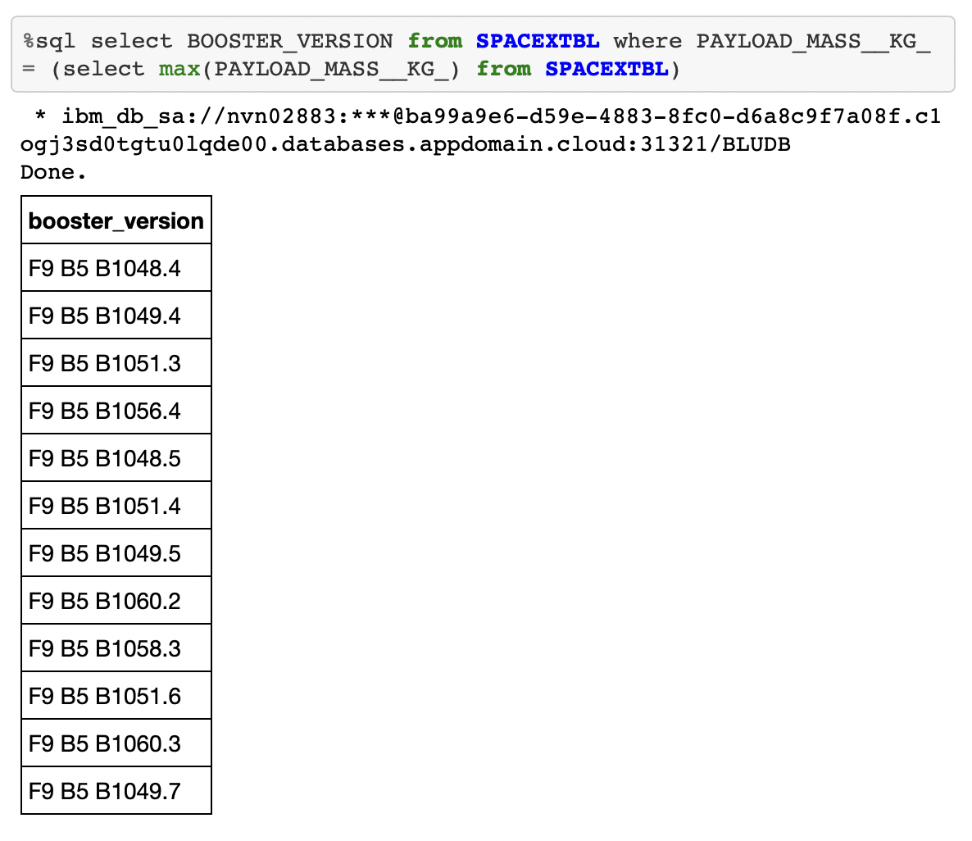
Boosters Carried Maximum Payload
We curate the list the names of the booster which have carried the maximum payload mass by using subquery of a ‘where’ clause set to max payload.

Slide 30
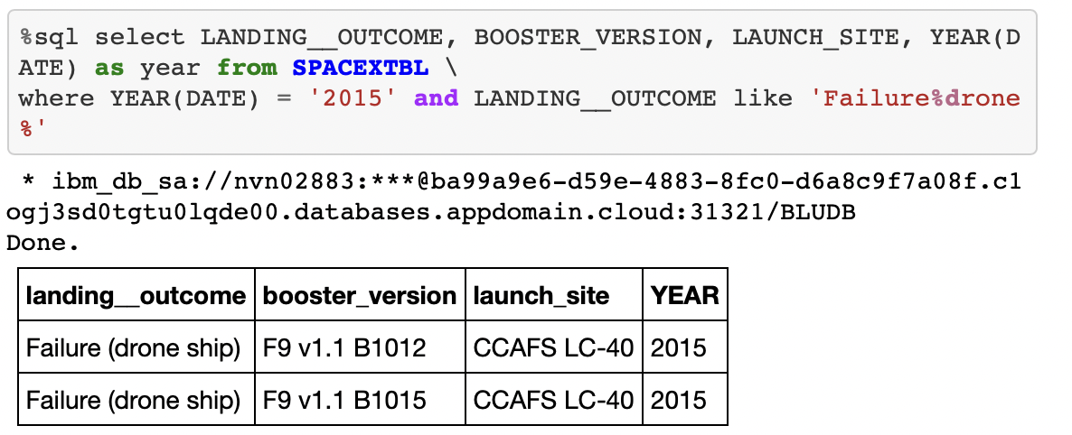
2015 Launch Records
List the failed landing_outcomes in drone ship, their booster versions, and launch site names for in year 2015 by selecting the relevant columns and using the ‘where’ clause to limit the year to 2015 and landing outcomes to contain ‘failure’ and ‘drone’.

Slide 31
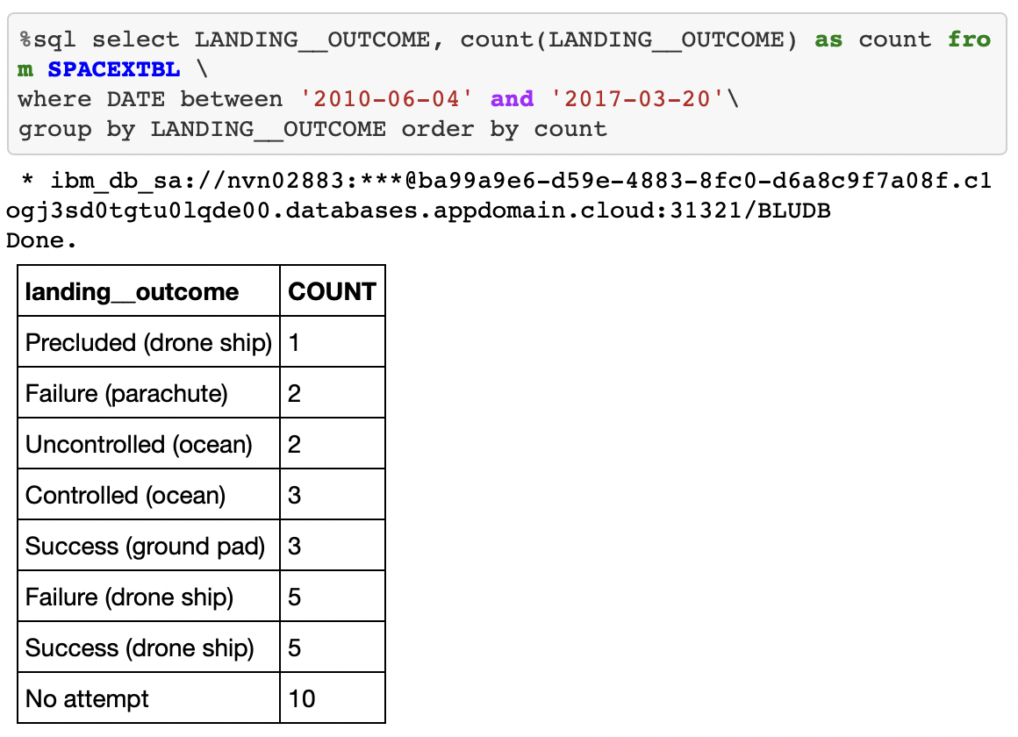
Rank Landing Outcomes Between 2010-06-04 and 2017-03-20
Rank the count of landing outcomes between the date 2010-06-04 and 2017-03-20 and group by their landing outcomes.

Slide 32


Slide 33
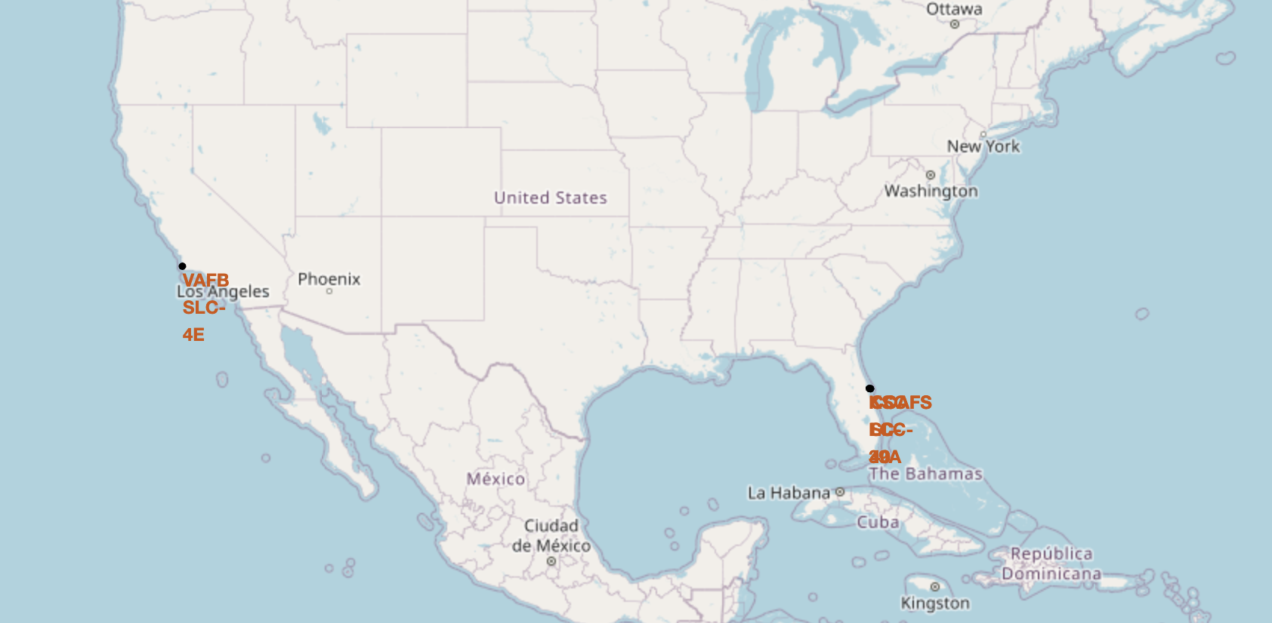
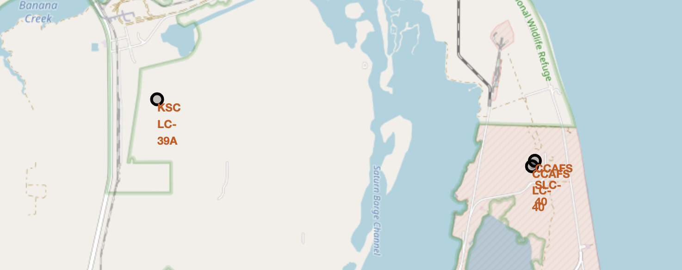
Launch Sites on Map
VAFB SLC-4E is situated on the West coast of United States while the other sites are on the East coast of United States. In the close up view, it shows CCAFS LC-40 and CCAFS SLC-40 are right next to one another while KSC LC-39 is a little further from the two sites.

Slide 34
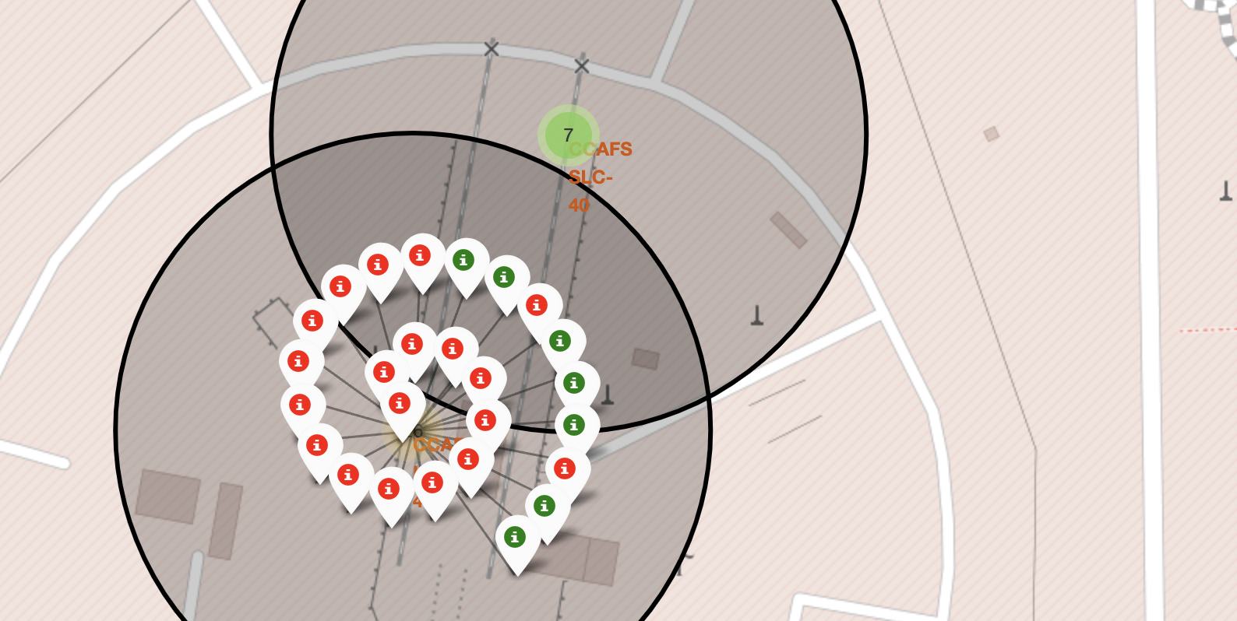
Color-labeled launch outcomes of CCAFS LC-40
26 launch outcomes of CCAFS LC-40 is labelled in respectively in green for success and red for failure.

Slide 35
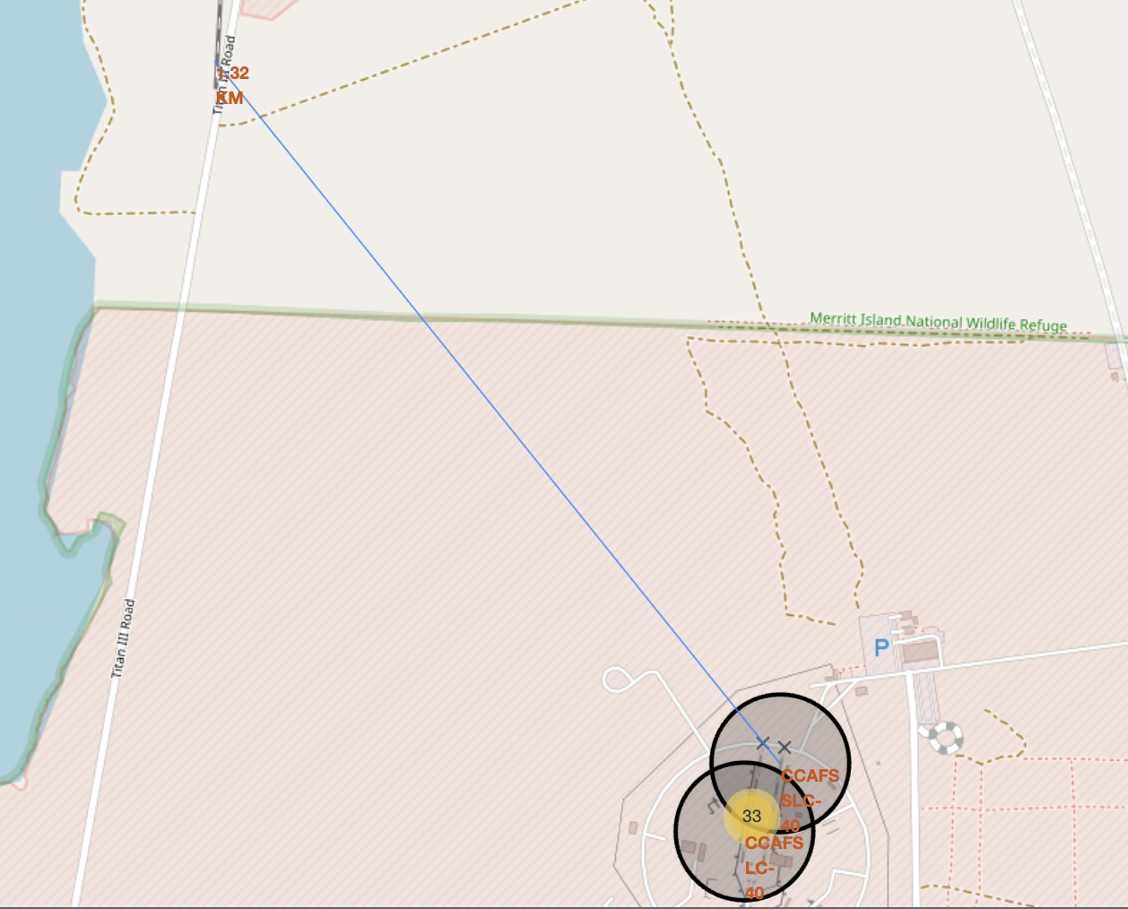
Distance between CCAFS SLC-40 and Railway
The map shows CCAFS SLC-40 and the nearest railway is 1.32km away from one another.

Slide 36


Slide 37
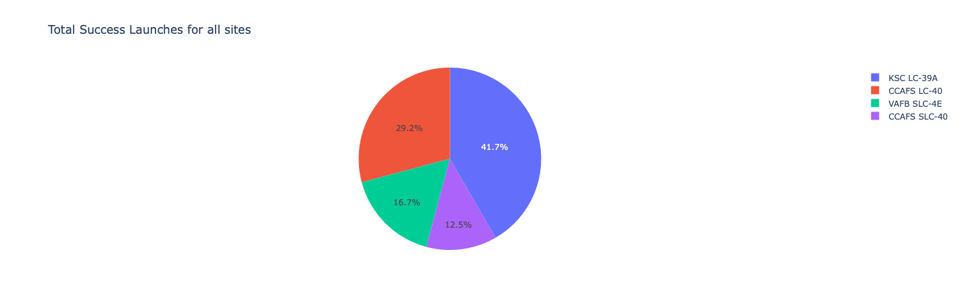
Success count for all launch sites
KSC LC – 39A has the largest number of successful launches at 41.7% or 10 counts.

Slide 38
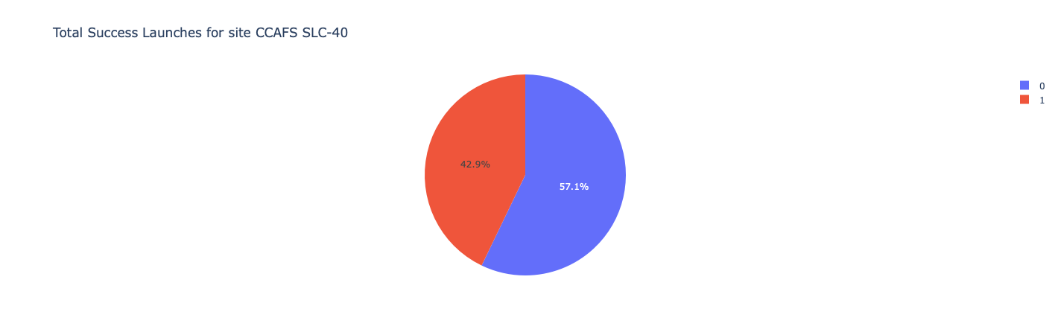
Launch site with highest launch success ratio
However, CCAFS SLC-40 has the highest ratio of successful launches of 42.9%.

Slide 39
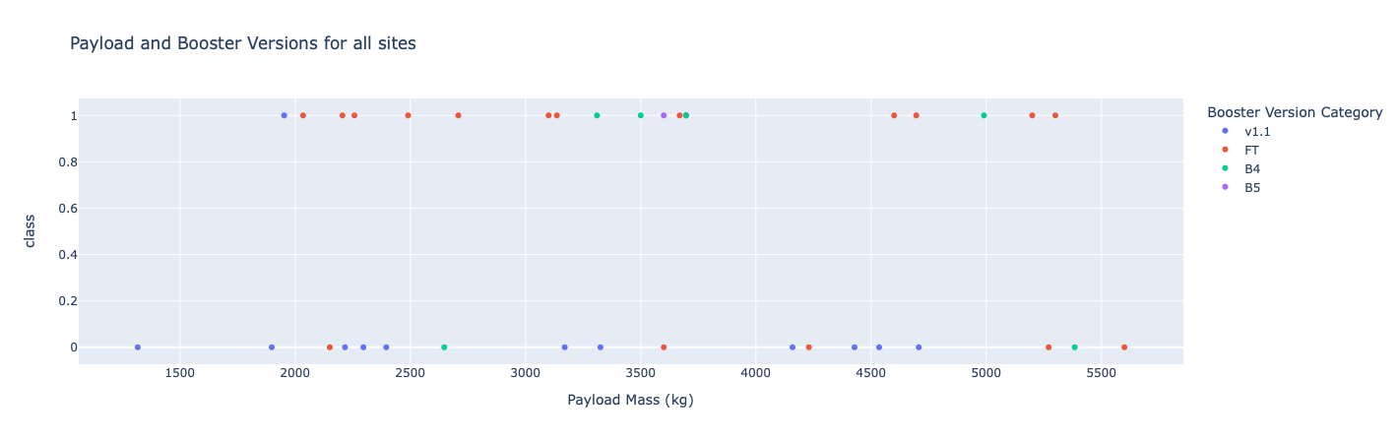
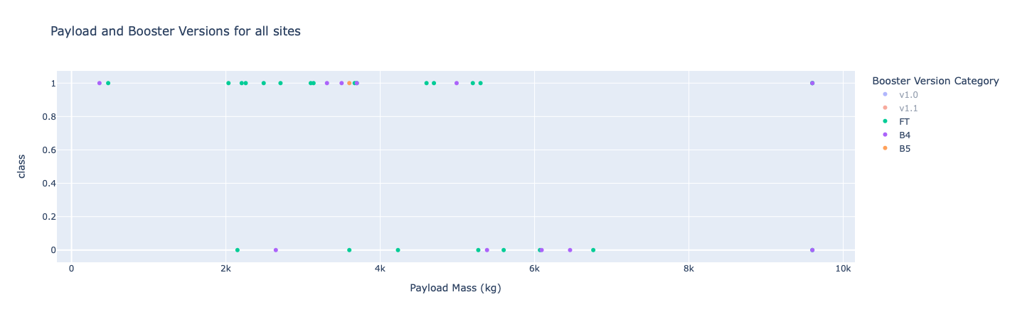
Payload and booster versions on successful launch
We can see payload range 2000 to 3750kg has the highest rate of success as we see the congregation at the top in comparison to the bottom.
As booster B5 has only 1 launch and it’s successful, it has the highest ratio. If we exclude B5 for its small sample size, FT and B4 has higher success ratio with FT having more edge.

Slide 40


Slide 41
Classification Accuracy
Accuracy for the built classification model is 0.833334 for all models - SVM, Classification Trees, Logistic Regression and KNN. Hence they are equivalent of one another and all models can be used.

Slide 42
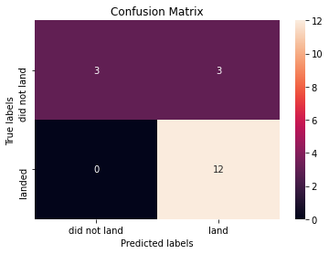
Confusion Matrix
The confusion matrix for all models is the same. The weakness is the number of false positives as seen in the top right square.

Slide 43
Conclusions
Data can be extracted from API or webscraped from online sources such as Wikipedia.
Exploratory analysis can be using various methods such as SQL queries, visualization using charts, interactive dashboards as well as maps when needed.
Features including ‘FlightNumber', 'PayloadMass', 'Orbit', 'LaunchSite', 'Flights', 'GridFins', 'Reused', 'Legs', 'LandingPad', 'Block', 'ReusedCount’ are important variables.
Later flight numbers indicate the flights launched at later timeline, hence we can observe flights at later are more successful since it builds on experience of previous flights.
Accuracy for the built classification model is equivalent for all models - SVM, Classification Trees, Logistic Regression and KNN. Issue may rise for false positives.

Slide 44
Appendix
All required can be found in this Github link:
https://github.com/Dotmeads/IBMCapstoneSpaceX.git

